Slide 1
Apache Kafka
message queue system

Slide 2
What is Kafka
Transfer the big data from one application to another application
It is a message queue system, it creates the pipelines to transfer the data
While transferring the data, Kafka contains
Security
Reliable
Speed
Availability
Scalability
Fault-tolerance

Slide 3
Security: Kafka supports cluster encryption and authentication, including a mix of authenticated and unauthenticated, and encrypted and non-encrypted clients. Using security is optional. Here a few relevant client-side security features: Encrypt data-in-transit between your applications and Kafka brokers.
Reliable: Kafka persists the messages on the disks, which provides intra-cluster replication. This makes for a highly durable messaging system. Kafka is Highly Reliable. Kafka replicates data and is able to support multiple subscribers.
Availability: First, some facts about high availability in Kafka: The number of partitions doesn't have to be equal to the number of brokers. Partitions are automatically distributed across available brokers based on the configured “replication factor”. At any time ONLY ONE broker can be the leader for a given partition.
Scalability: one of the major advantages of using Kafka is that it is highly scalable. In times of any node failure, Kafka allows for quick and automatic recovery. In a world that now deals with high volumes of real-time data, this feature makes Kafka a hands down choice for data communication and integration.
Fault-tolerance: Kafka Streams builds on fault-tolerance capabilities integrated natively within Kafka. Kafka partitions are highly available and replicated; so when stream data is persisted to Kafka it is available even if the application fails and needs to re-process it

Slide 4
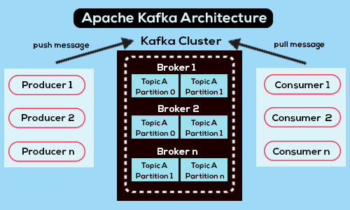

Slide 5
History
Kafka was discovered by LinkedIn
Single monolithic application (Leo), serve the web pages in Leo
Web pages to store the data, the traffic of data was increased
They faced the problems while transfer the huge data, initially they have the custom data pipeline.
They used the stream data and queue the data through data pipeline, faced the some lags when streaming the big data
They introduced the distributed messaging system → Kafka
LinkedIn converted the kafka into open source in 2011
Apache foundation adapted the kafka, used java in kafka for updation and release the updated version in 2012
In 2022 major IT companies are used this kafka messaging solutions

Slide 6
Apache Kafka
Distributed streaming platform
Publish/subscribe the data/message and stream of records with any format of data
Stores the stream of records with fault availability
We can customize the kafka with our needs, real time data transfer
Kafka has cluster
Collection of kafka brokers(servers)
If the one server down/not working the data will be stored in distributed form in 3 servers, if one server is down we can not loose the data
cluster
Server - 1
Server - 2
Server - 3

Slide 7
Each server has the Topic and each Topic has Records(data)
Records are called as partitions, each partition has offsets
These offsets are storing the data
Offset :
Each element with in the partition with increment value
Each partition is independent to itself
The default time of storing the data in kafka for 7 days, we can change this time also
Data assigned to the offsets or topics randomly or we can select the specific Topic, Partition, Offset.
We have to just send the data everything will be managed by kafka

Slide 8
Cluster Architecture
Offset
cluster
Topic
0 1 2
0 1 2
server
0 1 2
0 1 2
Records/data/partitions

Slide 9
If one client connect to the server in cluster means he is connect to the all servers in that cluster
We have to select the servers only, remaining things like partitions/topics are managed by background algorithm of kafka
Topic has Replication factor
The multiple copies of data stored across several kafka servers is called Replication factor
The kafka replication factor allows kafka to provide high availability of data and prevent data loss, if the server goes down or can not handle the request
Default replication factor is = 1
If replication factor is 2 means
Let assume we have 3 servers , the server one has some data , server two has server one data and some another data. If one server down the another server serve the data to clients (we can not loose the data)
If replication factor is 3 means it is a golden
Let assume we have 3 servers , the server one has some data and server three data, server two has server one data and some another data, server three has server one and server two data with another some data If one server down means we can not loss the data
It has less change of loose the data

Slide 10
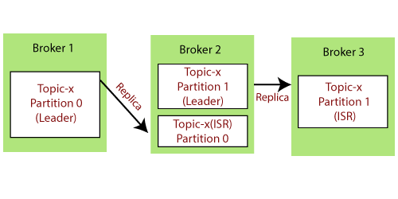
Zookeeper
Zookeeper acts a Kafka cluster coordinator that manages cluster membership of brokers, producers, and consumers participating in message transfers via Kafka. It also helps in leader election for a Kafka topic
In Kafka, for each topic partition, one broker is chosen as the leader for the other brokers (the followers). One of the chief duties of the leader is to assign replication of topic partitions to the follower brokers.
If leader server is down ISR(In Sync Replication) will be the leader ,when the leader server is on again it become leader

Slide 11
Acknowledgement
Acknowledgement (acks) = 0 This means that the producer sends the data to the broker but does not wait for the acknowledgement this cause data loss
acks = 1, it is default producer wait for the a acknowledgement it cause limited data loss
acks=all: Here, the acknowledgment is done by both the leader and its followers. When they successfully acknowledge the data, it means the data is successfully received. In this case, there is no data loss.
Once Kafka receives an acknowledgement, it changes the offset to the new value and updates it in the Zookeeper. Since offsets are maintained in the Zookeeper, the consumer can read next message correctly even during server outrages. This above flow will repeat until the consumer stops the request.

Slide 12
Producer and Messages
We can also send message + key to easily identify the message
Send message with same key it will goes to , when first time the key stored in that broker .
Producer write data to Topic’s . If any broker is shutdown or not working means the producer automatically select another broker to send data
Equally distributed the data to brokers(servers)

Slide 13
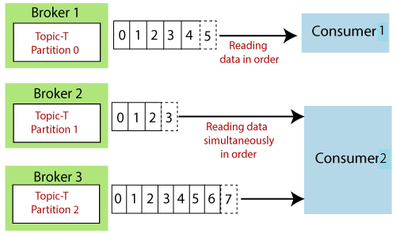
Consumer
Consumer knows which broker has the data , consumer read data from that broker. It is already there In the code. We can not explicitly mention, it is best advantage
It is like producer, when the consumer reads the data at the time the broker is down, consumer automatically reads data from another broker
If consumer want to read message 4 is impossible, first consumer read the 1,2,3 then only 4
There is no guarantee for if the consumer read data from only broker 1, if it can read 2 from broker 1, 3 from broker 3, 1 from broker 2

Slide 14
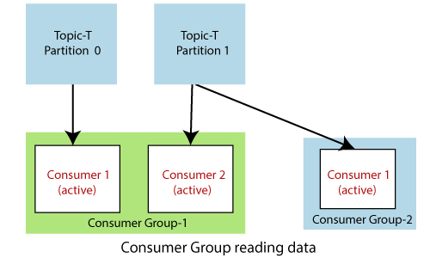
Consumer Group
A consumer group is a group of multiple consumers which visions to an application basically. Each consumer present in a group reads data directly from the exclusive partitions. In case, the number of consumers are more than the number of partitions, some of the consumers will be in an inactive state.

Slide 15
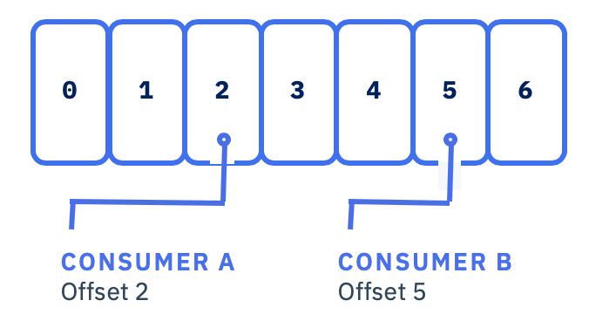
Consumer offset
Apache Kafka provides a convenient feature to store an offset value for a consumer group. It stores an offset value to know at which partition, the consumer group is reading the data. As soon as a consumer in a group reads data, Kafka automatically commits the offsets, or it can be programmed. These offsets are committed live in a topic known as __consumer_offsets. This feature was implemented in the case of a machine failure where a consumer fails to read the data. So, the consumer will be able to continue reading from where it left off due to the commitment of the offset.

Slide 16
Alternate to Kafka
IBM MQ.
Mule Soft Any point Platform.
Apache Qpid.
Azure Scheduler.
IBM Cloud Pak for Integration.
Nastel.
RabbitMQ

Slide 17


